Slide 1
Astute Irrigation System and Crop Management
Lasya Vadapalli (501528)
Suraj Padhy (501541)
Yashshree Patil (501546)
Rashmi Pawar (501548)

Slide 2
Problem Statement
Agriculture serves as the backbone of the Indian Subcontinent which suffice the need of most of the population. It is observed that still some part of population is deprived of this basic need of food. The only way to satisfy is through increasing the productivity in agriculture.
Our project defines a completely automated system that will address the problems of the traditional irrigation system and also gives the farmer an extra helping hand to get best in his returns.
Scope
1. Providing automation of some of the irrigation tasks.
2. Developing some tasks of crop management system.
3. Providing decision making system for marketing.

Slide 3
Block Diagram of the Entire System
Temp
Sensor
Moisture sensor
ADC
Raspberry pi3
Cloud database
Water level sensor
pH sensor
Local controller
Power supply
Mobile application
Water pump
Relay
End user

Slide 4
Implementation Details
Hardware Requirements:
Raspberry pi 3
Soil Temperature Sensor (DS18b20)
Soil Moisture Sensor (KG003)
Ultrasonic Sensor (HC-SR04)
Single Channel 5v Relay
3v-6v DC water pump
Analog to Digital Converter (ADS1115)
Software Requirements:
Visual Studio 2017 with Xamarin tools plugin.
Azure Cloud server Account

Slide 5
Installation of Raspbian on Raspberry pi 3.
The raspbian is installed on 8gb memory card. To install raspbian first step is to format the memory card in order to make it suitable for installation. To format memory card SD Memory card format tool 5.0 is used. Steps to format the memory card are as follows:
Download SD Memory card format tool from ​www.sdcard.org\downloads\​.
Install the memory card formatting tool.
Format memory card as FAT.
Once formatting is completed, memory card is ready for use.

Slide 6
Once the memory card is formatted, it is ready for use. The next step is to download theoperating system either raspbian or noobs from official website https://www.raspberrypi.org/downloads/​. After downloading the system image of raspbian extract the zip file to some folder.
Next step is to write this downloaded system image to memory card. For this purpose ​Etcher tool is used. Steps to write system image to memory card are as follows:
Download ​Etcher​and install it from ​https://etcher.io/​.
Connect an SD card reader with the SD card inside.
Open Etcher and select from your hard drive the Raspberry Pi ​.img or ​.zip file you wish to write to the SD card.
Select the SD card you wish to write your image to.
Review your selections and click 'Flash!' to begin writing data to the SD card.

Slide 7
Once the system image is written to memory card, insert that memory card into raspberry pi and power on the raspberry pi. On the first boot it will take you through all the normal installation steps. Once you are done with that raspberry pi is ready for use.

Slide 8
Connecting Temperature sensor to Raspberry pi3
DS18B20 is used for measuring the soil temperature. It is one wire interface sensor, very common in PCB embedded electrical circuits. Its unique one wire protocol requires only one port pin for communication and needs no other external components to work. It is waterproof sensor hence it can be used in humid and wet environmental conditions. It can operate on 3.3v and 5.5v.
This sensor has 3 pins.
a.Vcc - 5V
b.Gnd - Gnd
c.Data

Slide 9
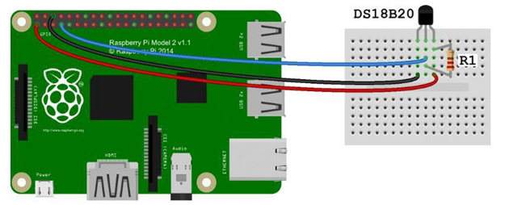
Circuit Diagram

Slide 10
Enable the One wire Interface
Before the Pi can receive any data from sensor, the One-Wire interface has to be enabled. Once the DS18B20 is connected, power up the Pi and log in, then these steps have to be done
At the command prompt, enter: sudo nano /boot/config.txt, then add this to the bottom of the file: dtoverlay=w1–gpio
Exit Nano, and reboot the Pi (sudo reboot)
Log in to the Pi again, and at the command prompt enter sudo modprobe w1–gpio
Then enter sudo modprobe w1-therm

Slide 11
Change directories to the /sys/bus/w1/devices directory by entering: cd /sys/bus/w1/devices
Now enter ls to list the devices:
Enter cat w1_slave which will show the raw temperature reading output by the sensor: af 01 4b 46 7f ff 01 10 bc : crc=bc YES
af 01 4b 46 7f ff 01 10 bc t=26937
For eg:​if temperature reading is t=28625, it means a temperature of 28.625 degrees Celsius.
sudo modprobe w1-gpio ; sudo modprobe w1-therm must be run every time the raspberry pi is turned on in order for the RPi to read the sensor. Each DS18B20 you plug in has its own directory in the format of 28-xxxxxxxxxxxx. After execution of above steps, it displays two lines of text. The first line will either have a YES or NO at the very end; if you receive a NO, there was a temporary error, so try again; if you receive a YES, the second line will display the temperature in Celsius.

Slide 12
Connecting Soil Moisture Sensor to Raspberry pi 3
KG003 soil moisture sensor is used to measure the soil moisture.
The soil moisture sensor consists of two probes. The two probes allow the current to pass through the soil and then it gets the resistance value to measure the moisture value.
When there is more water, the soil will conduct more electricity which means that there will be less resistance. Therefore, the moisture level will be higher. Dry soil conducts electricity poorly, so when there will be less water, the soil will conduct less electricity which means that there will be more resistance. Therefore, the moisture level will be lower.
The sensor has 4 pins. First two pins are Vcc and GND. The next two pins are output pins.A0 pin is giving analog output and D0 pin is giving digital output. We are using analog output of sensor to get readings. As raspberry pi does not have any analog pin, we have to use an ADC to convert analog output of sensor into digital. The ADC used here is ADS1115.

Slide 13
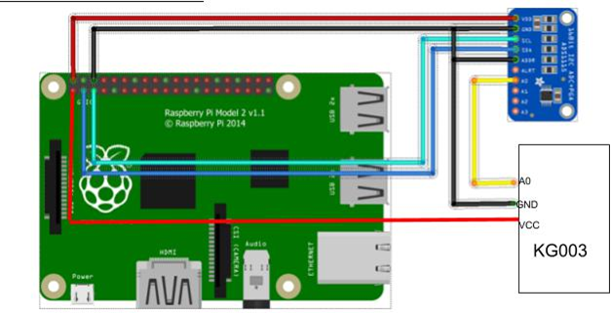
Circuit Diagram The VDD pin is connected to 3.3V supply on breadboard. The GND pin is connected to ground on breadboard. The SCL pin is connected to pin 5 of raspberry pi and SDA to pin3. The analog output of the sensor from pin A0 is given to A0 pin of ADC which is analog input pin. In order to communicate with raspberry pi, the I2C pins(pin3 and pin5) should be set to high. To check whether the I2C pins is enabled or not type the following command: gpio readall

Slide 14
After connecting ADC to raspberry pi, we have installed python library required for ADC. Steps to install library are as follows:
First we have to make sure that we have installed git. If we don't have git installed then we have to install it first. To install git,
sudo apt-get install git
2. After installing git, we have to clone git repository.
git clone https://github.com/adafruit/Adafruit_Python_ADS1x15.git
After cloning repository it will create folder on raspberry pi. Go to folder Adafruit_python_ADS1x15.
cd Adafruit_python_ADS1x15
Then we have to install this library. To install type following command: sudo python setup.py install
Once it is successfully completed library is ready to use.We can then write down codes for ADC

Slide 15
Connecting Ultrasonic sensor to raspberry pi 3.
HC-SR 04 ultrasonic distance sensor is used to measure water level in storage tank. This sensor operates on 5V.
The maximum measuring distance is 200cm.The Ultrasonic transmitter transmits an ultrasonic wave, this wave travels in air and when it gets objected by water it gets reflected back toward the sensor this reflected wave is observed by the Ultrasonic receiver.
Once the signal is received by receiver using time distance speed formula we can calculate the water level in the tank. A basic ultrasonic sensor consists of one or more ultrasonic transmitters (basically speakers), a receiver, and a control circuit. The transmitters emit a high frequency ultrasonic sound, which bounce off any nearby objects. Some of that ultrasonic noise is reflected and detected by the receiver on the sensor.

Slide 16
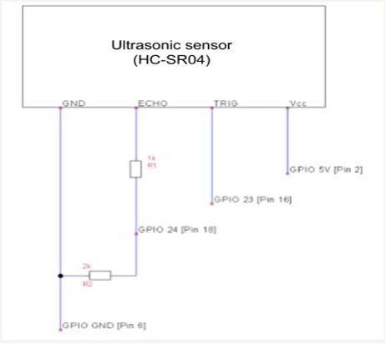
Circuit Diagram

Slide 17
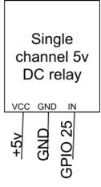
Connecting Relay to raspberry pi3.
The single channel 5v relay is used to control the water pump. The operating voltage of the relay is 5v. This relay is connected to GPIO pin of raspberry pi. Whenever the moisture level is below threshold value water pump is switched on using the relay and also water pump is switched off once threshold level is reached

Slide 18
Installing Visual studio 2017 with Xamarin
Xamarin can be installed as part of a new Visual Studio 2017 installation. To achieve this, use the following steps:
Download Visual Studio 2017 Community(free for students), Visual Studio Professional, or Visual Studio Enterprise from the Visual Studio page.
Double-click the downloaded package to start installation
Select the ​Mobile development with .NET​workload from the installation screen:

Slide 19
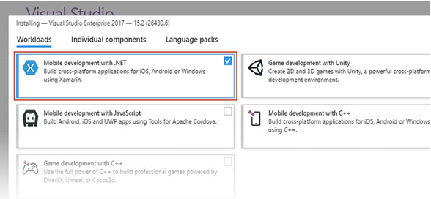

Slide 20
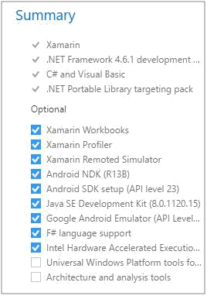
While ​Mobile development with .NET is selected, have a look at the ​Summary panel on the right. Here, you can deselect mobile development options that you do not want to install. By default, all options shown in the following screenshot are installed (​Xamarin Workbooks​, ​Xamarin Profiler​, ​Xamarin Remoted Simulator​, ​Android NDK​, Android SDK​, ​Java SE Development Kit​, ​Google Android Emulator​, ​F# support​, and ​Intel HAXM​):

Slide 21
Creation Of Azure Account
Go to https://www.azure.com and click the green “Start free” button.
Next, click another “Start free” button.
If you already have an account with Microsoft, for example, Office 365, you’ll be prompted to log in.
Follow the prompts to verify your account by phone.
Next – tick “I agree” and click “Sign Up.”
Within few minutes account will be created and next step is Student verification.
Once the verification code from Microsoft is received,you can get access to the dashboard.

Slide 22
Thank You

